Slide 1
CS 229 – Machine Learning
Super VIP Cheatsheet: Machine Learning
Afshine Amidi and Shervine Amidi
September 15, 2018
4 Machine Learning Tips and Tricks
10
4.1 Metrics . . . . . . . . . . . . . . . . . . . . . . . . . . . . . . . . . .10
4.1.1 Classification . . . . . . . . . . . . . . . . . . . . . . . . . . .10
4.1.2 Regression . . . . . . . . . . . . . . . . . . . . . . . . . . . .10
4.2 Model selection . . . . . . . . . . . . . . . . . . . . . . . . . . . . . .11
4.3 Diagnostics . . . . . . . . . . . . . . . . . . . . . . . . . . . . . . . .11
5 Refreshers
5.1 Probabilities and Statistics . . . . . . . . . . . . . . . . . . . . . . . .12
12
Contents
5.1.1 Introduction to Probability and Combinatorics . . . . . . . . .12
5.1.2 Conditional Probability . . . . . . . . . . . . . . . . . . . . .12 5.1.3 Random Variables . . . . . . . . . . . . . . . . . . . . . . . .13
5.1.4 Jointly Distributed Random Variables . . . . . . . . . . . . . .13
5.1.5 Parameter estimation . . . . . . . . . . . . . . . . . . . . . .14
5.2 Linear Algebra and Calculus . . . . . . . . . . . . . . . . . . . . . . .14 5.2.1 General notations . . . . . . . . . . . . . . . . . . . . . . . .14
1 Supervised Learning
2
Introduction to Supervised Learning . . . . . . . . . . . . . . . . . . .2
Notations and general concepts . . . . . . . . . . . . . . . . . . . . .2 1.3 Linear models . . . . . . . . . . . . . . . . . . . . . . . . . . . . . .2 1.3.1 Linear regression . . . . . . . . . . . . . . . . . . . . . . . . .2
Classification and logistic regression . . . . . . . . . . . . . . .3
Generalized Linear Models . . . . . . . . . . . . . . . . . . . .3 1.4 Support Vector Machines . . . . . . . . . . . . . . . . . . . . . . . .3 1.5 Generative Learning . . . . . . . . . . . . . . . . . . . . . . . . . . .4
1.5.1 Gaussian Discriminant Analysis . . . . . . . . . . . . . . . . .4 1.5.2 Naive Bayes . . . . . . . . . . . . . . . . . . . . . . . . . . .4
Tree-based and ensemble methods . . . . . . . . . . . . . . . . . . . .4
Other non-parametric approaches . . . . . . . . . . . . . . . . . . . .4 1.8 Learning Theory . . . . . . . . . . . . . . . . . . . . . . . . . . . . .5
5.2.2 Matrix operations . . . . . . . . . . . . . . . . . . . . . . . .15
5.2.3 Matrix properties . . . . . . . . . . . . . . . . . . . . . . . .15
5.2.4 Matrix calculus . . . . . . . . . . . . . . . . . . . . . . . . .16
Unsupervised Learning
Introduction to Unsupervised Learning . . . . . . . . . . . . . . . . .6 2.2 Clustering . . . . . . . . . . . . . . . . . . . . . . . . . . . . . . . .6
2.2.1 Expectation-Maximization . . . . . . . . . . . . . . . . . . . .6 2.2.2 k-means clustering . . . . . . . . . . . . . . . . . . . . . . . .6
2.2.3 Hierarchical clustering . . . . . . . . . . . . . . . . . . . . . .6
2.2.4 Clustering assessment metrics . . . . . . . . . . . . . . . . . .6 2.3 Dimension reduction . . . . . . . . . . . . . . . . . . . . . . . . . . .7
Principal component analysis . . . . . . . . . . . . . . . . . .7
Independent component analysis . . . . . . . . . . . . . . . . .7
3 Deep Learning
3.1 Neural Networks . . . . . . . . . . . . . . . . . . . . . . . . . . . . .8
3.2 Convolutional Neural Networks . . . . . . . . . . . . . . . . . . . . .8
3.3 Recurrent Neural Networks . . . . . . . . . . . . . . . . . . . . . . .8
3.4 Reinforcement Learning and Control . . . . . . . . . . . . . . . . . . .9
6
8

Slide 2
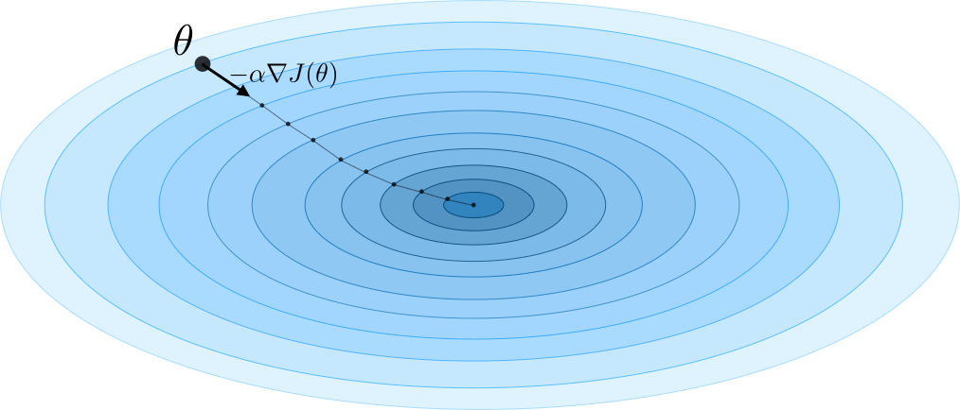
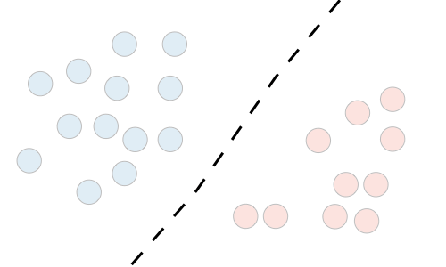
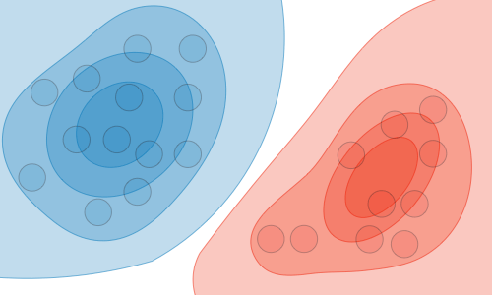
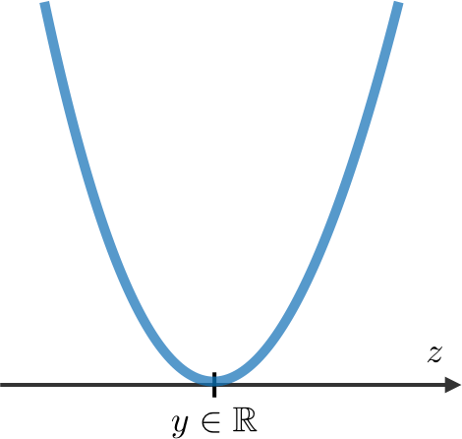
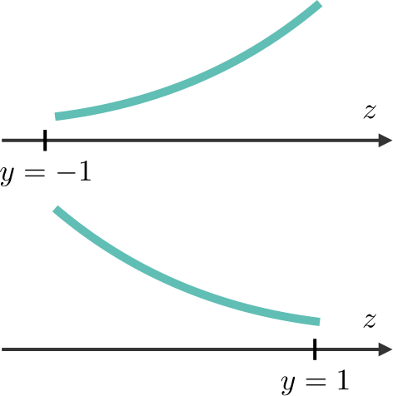
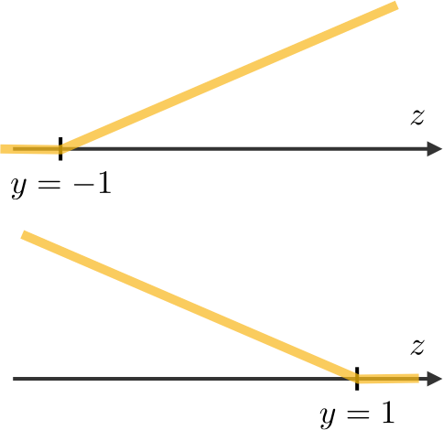
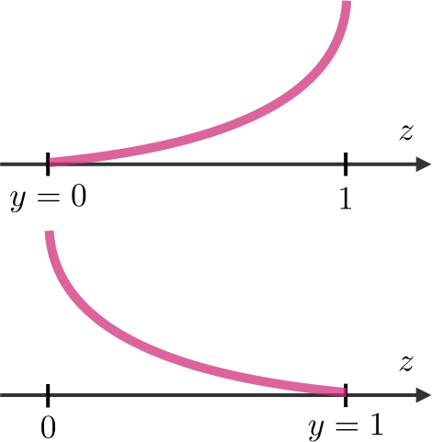
CS 229 – Machine Learning
Shervine Amidi & Afshine Amidi
Supervised Learning
Introduction to Supervised Learning
Cost function – The cost function J is commonly used to assess the performance of a model, and is defined with the loss function L as follows:
Σ
m
(i) (i)
J(θ) = L
(h (x ), y )
(1) ( ) (1) m
θ
Given a set of data points {x , ..., x ^{m} } associated to a set of outcomes {y , ..., y⁽ ⁾}, we
i=1
want to build a classifier that learns how to predict y from x.
Type of prediction – The different types of predictive models are summed up in the table
below:
Gradient descent – By noting α ∈ R the learning rate, the update rule for gradient descent
 | Regression | Classifier
Outcome | Continuous | Class
Examples | Linear regression | Logistic regression, SVM, Naive Bayes
is expressed with the learning rate and the cost function J as follows:
θ ←− θ − α∇J(θ)
Type of model – The different models are summed up in the table below:
 | Discriminative model | Generative model
Goal | Directly estimate P (y|x) | Estimate P (x|y) to deduce P (y|x)
What’s learned | Decision boundary | Probability distributions of the data
Illustration
Examples | Regressions, SVMs | GDA, Naive Bayes
Remark: Stochastic gradient descent (SGD) is updating the parameter based on each training example, and batch gradient descent is on a batch of training examples.
Likelihood – The likelihood of a model L(θ) given parameters θ is used to find the optimal parameters θ through maximizing the likelihood. In practice, we use the log-likelihood A(θ) = log(L(θ)) which is easier to optimize. We have:
θ^{opt} = arg max L(θ)
θ
1.2 Notations and general concepts
Hypothesis – The hypothesis is noted h_{θ} and is the model that we choose. For a given input data x^{(i)}, the model prediction output is h_{θ} (x^{(i)}).
Newton’s algorithm – The Newton’s algorithm is a numerical method that finds θ such that A^{j}(θ) = 0. Its update rule is as follows:
A^{j}(θ) θ ← θ − _{Ajj(θ)}
Loss function – A loss function is a function L : (z,y) ∈ R × Y −→ L(z,y) ∈ R that takes as
inputs the predicted value z corresponding to the real data value y and outputs how different they are. The common loss functions are summed up in the table below:
Remark: the multidimensional generalization, also known as the Newton-Raphson method, has the following update rule:
. Σ
−1
2
Least squared | Logistic | Hinge | Cross-entropy
¹ (y − z)² 2 | log(1 + exp(−yz)) | max(0,1 − yz) | −^{Σ}y log(z) + (1 − y) log(1 − z)^{Σ}
Linear regression | Logistic regression | SVM | Neural Network
θ ← θ − ∇ A(θ) ∇ A
(θ)
θ
θ
Linear models
Linear regression
We assume here that y|x; θ ∼ N (µ,σ²)
Normal equations – By noting X the matrix design, the value of θ that minimizes the cost function is a closed-form solution such that:
θ = (X^{T} X)⁻¹X^{T} y

Slide 3
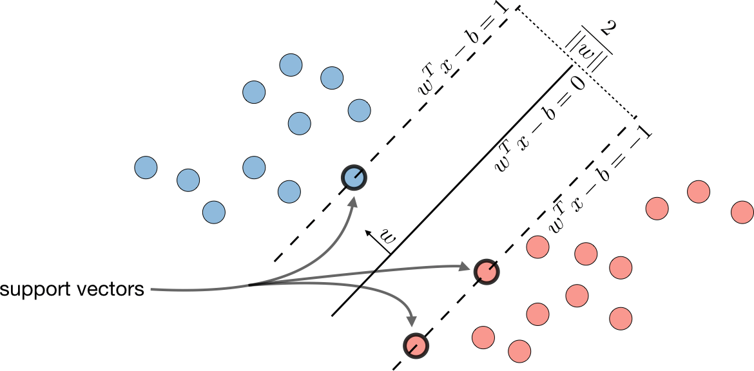
CS 229 – Machine Learning
LMS algorithm – By noting α the learning rate, the update rule of the Least Mean Squares (LMS) algorithm for a training set of m data points, which is also known as the Widrow-Hoff learning rule, is as follows:
Distribution | η | T (y) | a(η) | b(y)
Bernoulli | log . ₁ ^{φ Σ} −φ | y | log(1 + exp(η)) | 1
Gaussian | µ | y | _{η}2 2 | ₁ . _{y2} Σ √_{2π} exp − ₂
Poisson | log(λ) | y | _{e}η | 1 y!
Geometric | log(1 − φ) | y | log ^{. eη Σ} 1−e^{η} | 1
Σ
m
Σ Σ
(i)
j
(i) (i)
∀j, θj ← θj + α y − h_{θ} (x ) x
i=1
Remark: the update rule is a particular case of the gradient ascent.
LWR – Locally Weighted Regression, also known as LWR, is a variant of linear regression that weights each training example in its cost function by w^{(i)}(x), which is defined with parameter τ ∈ R as:
. Σ
(i) 2
(i)
(x − x)
Assumptions of GLMs – Generalized Linear Models (GLM) aim at predicting a random variable y as a function fo x ∈ R^{n+1} and rely on the following 3 assumptions:
w (x) = exp −
2τ ²
(1) y|x; θ ∼ ExpFamily(η) (2) h_{θ} (x) = E[y|x; θ] (3) η = θ^{T} x
1.3.2 Classification and logistic regression
Sigmoid function – The sigmoid function g, also known as the logistic function, is defined as follows:
Remark: ordinary least squares and logistic regression are special cases of generalized linear models.
1
1.4 Support Vector Machines
The goal of support vector machines is to find the line that maximizes the minimum distance to the line.
Optimal margin classifier – The optimal margin classifier h is such that:
∀z ∈ R, g(z) = _{1 + e−z} ∈]0,1[
Logistic regression – We assume here that y|x; θ ∼ Bernoulli(φ). We have the following
form:
h(x) = sign(w^{T} x − b)
φ = p(y = 1|x; θ) =
1
T
T
= g(θ x)
1 + exp(−θ x)
where (w, b
n
) ∈ R × R is the solution of the following optimization problem:
Remark: there is no closed form solution for the case of logistic regressions.
Softmax regression – A softmax regression, also called a multiclass logistic regression, is used to generalize logistic regression when there are more than 2 outcome classes. By convention, we set θ_{K} = 0, which makes the Bernoulli parameter φi of each class i equal to:
1
2
min ||w||
such that y^{(i)}(w^{T} x^{(i)} − b) “ 1
2
exp(θ^{T} x)
_{φi =} i
Σ
K
exp(θ^{T} x)
j=1
j
1.3.3 Generalized Linear Models
Exponential family – A class of distributions is said to be in the exponential family if it can be written in terms of a natural parameter, also called the canonical parameter or link function, η, a sufficient statistic T (y) and a log-partition function a(η) as follows:
p(y; η) = b(y) exp(ηT (y) − a(η))
Remark: the line is defined as w^{T} x − b = 0 .
Remark: we will often have T (y) = y. Also, exp(−a(η)) can be seen as a normalization param-
eter that will make sure that the probabilities sum to one.
Here are the most common exponential distributions summed up in the following table:
Hinge loss – The hinge loss is used in the setting of SVMs and is defined as follows:
L(z,y) = [1 − yz]+ = max(0,1 − yz)

Slide 4
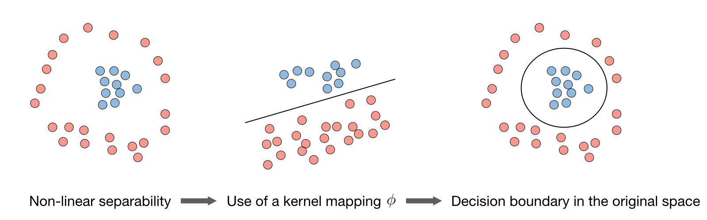
CS 229 – Machine Learning
Kernel – Given a feature mapping φ, we define the kernel K to be defined as:
1.5.2 Naive Bayes
Assumption – The Naive Bayes model supposes that the features of each data point are all independent:
K(x,z) = φ(x)^{T} φ(z)
. Σ
In practice, the kernel K defined by K(x,z) = exp −
||x−z||
2
is called the Gaussian kernel
2σ²
Y
and is commonly used.
n
P (x|y) = P (x1,x2,...|y) = P (x1|y)P (x2|y)... = P (xi|y)
i=1
Solutions – Maximizing the log-likelihood gives the following solutions, with k ∈ {0,1}, l ∈ [ 1,L]
(j)
(j)
1
#{j|y = k and x = l}
P (y = k) = × #{j|y^{(j)} = k}
and P (xi = l|y = k) =
i
m
#{j|y^{(j)} = k}
Remark: we say that we use the "kernel trick" to compute the cost function using the kernel because we actually don’t need to know the explicit mapping φ, which is often very complicated. Instead, only the values K(x,z) are needed.
Remark: Naive Bayes is widely used for text classification and spam detection.
Lagrangian – We define the Lagrangian L(w,b) as follows:
Σ
1.6 Tree-based and ensemble methods
These methods can be used for both regression and classification problems.
CART – Classification and Regression Trees (CART), commonly known as decision trees, can be represented as binary trees. They have the advantage to be very interpretable.
Random forest – It is a tree-based technique that uses a high number of decision trees built out of randomly selected sets of features. Contrary to the simple decision tree, it is highly uninterpretable but its generally good performance makes it a popular algorithm.
Remark: random forests are a type of ensemble methods.
Boosting – The idea of boosting methods is to combine several weak learners to form a stronger one. The main ones are summed up in the table below:
L(w,b
l
) = f (w) + β
h (w)
i=1
i i
Remark: the coefficients β are called the Lagrange multipliers.
i
1.5 Generative Learning
A generative model first tries to learn how the data is generated by estimating P (x|y), which
we can then use to estimate P (y|x) by using Bayes’ rule.
1.5.1 Gaussian Discriminant Analysis
Setting – The Gaussian Discriminant Analysis assumes that y and x|y = 0 and x|y = 1 are such that:
Adaptive boosting | Gradient boosting
High weights are put on errors to improve at the next boosting step Known as Adaboost | - Weak learners trained on remaining errors
y ∼ Bernoulli(φ)
x|y = 0 ∼ N (µ0,Σ) and
x|y = 1 ∼ N (µ1,Σ)
Estimation – The following table sums up the estimates that we find when maximizing the likelihood:
1.7 Other non-parametric approaches
k-nearest neighbors – The k-nearest neighbors algorithm, commonly known as k-NN, is a non-parametric approach where the response of a data point is determined by the nature of its k neighbors from the training set. It can be used in both classification and regression settings.
Remark: The higher the parameter k, the higher the bias, and the lower the parameter k, the higher the variance.
φ | µj (j = 0,1)  | Σ 
_{1 Σ}m ¹{y^{(i)}=1} m i=1 | ^{Σm} 1 ( ) x^{(i)} i=1 {y ^{i} =j} ^{Σm} 1 ( ) i=1 {y ^{i} =j} | _{1 Σ}m (x^{(i)} − µ )(x^{(i)} − µ )^{T} _{m y}(i) _{y}(i) i=1

Slide 5
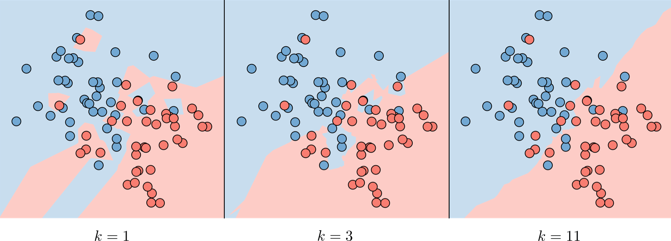
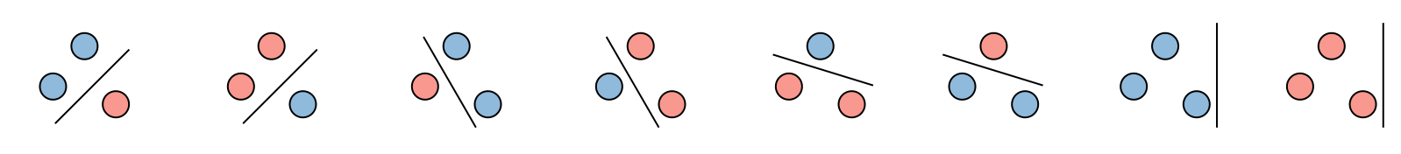
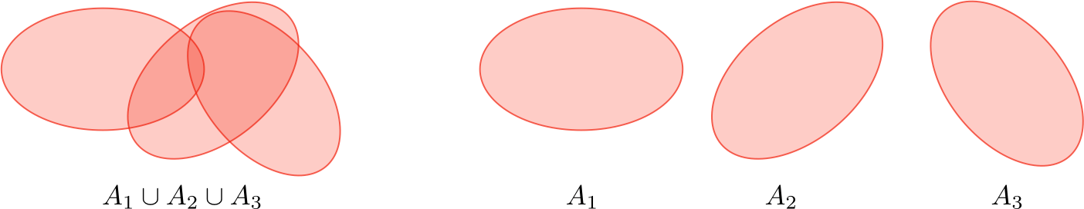
CS 229 – Machine Learning
Shervine Amidi & Afshine Amidi
∃h ∈ H, ∀i ∈ [ 1,d] ,
_{h(x}(i)_{) = y}(i)
Upper bound theorem – Let H be a finite hypothesis class such that |H| = k and let δ and the sample size m be fixed. Then, with probability of at least 1 − δ, we have:
. Σ
.
. Σ

1 2k
s(h) ™ min
s(h) + 2
log
h∈H
2m δ
VC dimension – The Vapnik-Chervonenkis (VC) dimension of a given infinite hypothesis class H, noted VC(H) is the size of the largest set that is shattered by H.
Remark: the VC dimension of H = {set of linear classifiers in 2 dimensions} is 3.
1.8 Learning Theory
Union bound – Let A1, ..., A_{k} be k events. We have:
P (A1 ∪ ... ∪ A_{k} ) ™ P (A1) + ... + P (A_{k} )
Theorem (Vapnik) – Let H be given, with VC(H) = d and m the number of training
examples. With probability at least 1 − δ, we have:
.. Σ
. Σ
. Σ
. Σ

d m
1 1
s(h) ™ min
s(h) + O
log
+ log
h∈H
m d
m δ
Hoeffding inequality – Let Z1, .., Zm be m iid variables drawn from a Bernoulli distribution

of parameter φ. Let φ be their sample mean and γ > 0 fixed. We have:

2
P (|φ − φ| > γ) ™ 2 exp(−2γ m)
Remark: this inequality is also known as the Chernoff bound.
Training error – For a given classifier h, we define the training error s(h), also known as the empirical risk or empirical error, to be as follows: 
Σ
1
m
(h) =
s _{m}
¹{h(x^{(i)})ƒ=y^{(i)} }
i=1
Probably Approximately Correct (PAC) – PAC is a framework under which numerous results on learning theory were proved, and has the following set of assumptions:
the training and testing sets follow the same distribution
the training examples are drawn independently
Shattering – Given a set S = {x⁽¹⁾,...,x^{(d)}}, and a set of classifiers H, we say that H shatters
S if for any set of labels {y⁽¹⁾, ..., y^{(d)}}, we have:

Slide 6
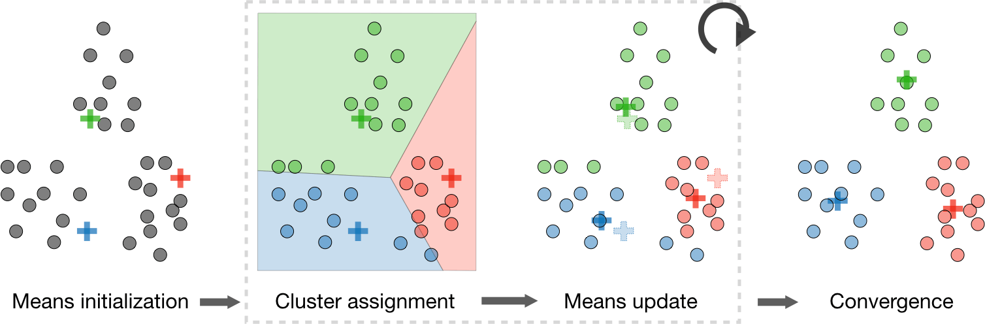
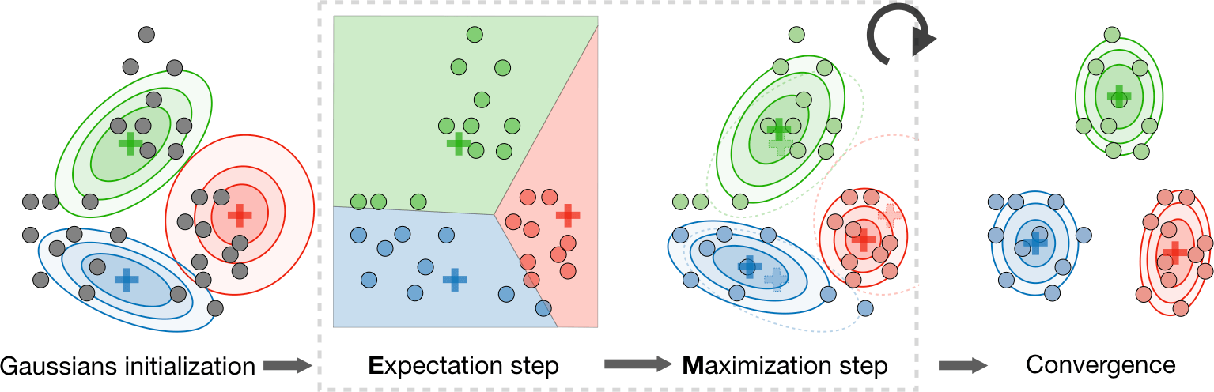
CS 229 – Machine Learning
Shervine Amidi & Afshine Amidi
Unsupervised Learning
Introduction to Unsupervised Learning
Motivation – The goal of unsupervised learning is to find hidden patterns in unlabeled data
{x⁽¹⁾,...,x^{(m)}}.
Jensen’s inequality – Let f be a convex function and X a random variable. We have the following inequality:
2.2.2 k-means clustering
We note c^{(i)} the cluster of data point i and µj the center of cluster j.
Algorithm – After randomly initializing the cluster centroids µ1,µ2,...,µ
n
algorithm repeats the following step until convergence:
k
∈ R , the k-means
Σ
m
1
x
(i)
(i)
(i)
(i)
2
i=1
{c =j}
c = arg min
||x − µ ||
and µj =
j
Σ
E[f (X)] “ f (E[X])
j
m
1
Clustering
Expectation-Maximization
Latent variables – Latent variables are hidden/unobserved variables that make estimation problems difficult, and are often denoted z. Here are the most common settings where there are latent variables:
i=1
{c^{(i)}=j}
Setting | Latent variable z | x|z | Comments
Mixture of k Gaussians | Multinomial(φ) | N (µj,Σj ) | µj ∈ R^{n}, φ ∈ R^{k}
Factor analysis | N (0,I) | N (µ + Λz,ψ) | µj ∈ R^{n}
Distortion function – In order to see if the algorithm converges, we look at the distortion function defined as follows:
Algorithm – The Expectation-Maximization (EM) algorithm gives an efficient method at estimating the parameter θ through maximum likelihood estimation by repeatedly constructing a lower-bound on the likelihood (E-step) and optimizing that lower bound (M-step) as follows:
( ^{(i)}) that each data point x^{(i)} came from
Σ
m
(i)
2
J(c,µ) = ||x − µ
_{c}(i)
||
E-step: Evaluate the posterior probability Qi z
i=1
a particular cluster z^{(i)} as follows:
2.2.3 Hierarchical clustering
Algorithm – It is a clustering algorithm with an agglomerative hierarchical approach that build nested clusters in a successive manner.
Types – There are different sorts of hierarchical clustering algorithms that aims at optimizing different objective functions, which is summed up in the table below:
Qi(z^{(i)}) = P (z^{(i)}|x^{(i)}; θ)
M-step: Use the posterior probabilities Q (z^{(i)}) as cluster specific weights on data points
(
i
x ^{i)} to separately re-estimate each cluster model as follows:
Σ
ˆ
. Σ
Ward linkage | Average linkage | Complete linkage
Minimize within cluster distance | Minimize average distance between cluster pairs | Minimize maximum distance of between cluster pairs
(i) (i)
θi = argmax
θ
Qi(z^{(i)}) log
P (x ,z ; θ)
( )
(
dz ^{i}
i
_{z}(i)
Qi(z ^{i)})
2.2.4 Clustering assessment metrics
In an unsupervised learning setting, it is often hard to assess the performance of a model since we don’t have the ground truth labels as was the case in the supervised learning setting.
Silhouette coefficient – By noting a and b the mean distance between a sample and all other points in the same class, and between a sample and all other points in the next nearest cluster, the silhouette coefficient s for a single sample is defined as follows:
_{s =} b − a
max(a,b)

Slide 7
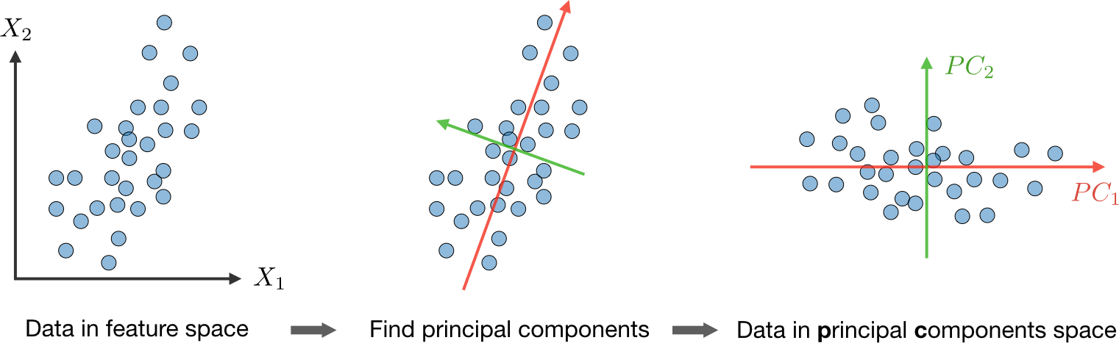
CS 229 – Machine Learning
Shervine Amidi & Afshine Amidi
Calinski-Harabaz index – By noting k the number of clusters, B_{k} and W_{k} the between and within-clustering dispersion matrices respectively defined as
Σ Σ
k m
B_{k} =
T
(i)
(i)
T
n (µ − µ)(µ − µ) ,
W_{k} = (x − µ )(
x − µ )
(i) (i)
(i)
(i)
(i)
c c
c
c
c
j=1 i=1
the Calinski-Harabaz index s(k) indicates how well a clustering model defines its clusters, such that the higher the score, the more dense and well separated the clusters are. It is defined as follows:
Tr(B ) N − k
s(k) =
k
×
2.3.2 Independent component analysis
It is a technique meant to find the underlying generating sources.
Assumptions – We assume that our data x has been generated by the n-dimensional source vector s = (s1,...,sn), where si are independent random variables, via a mixing and non-singular matrix A as follows:
Tr(W_{k} ) k − 1
Dimension reduction
Principal component analysis
It is a dimension reduction technique that finds the variance maximizing directions onto which to project the data.
x = As
Eigenvalue, eigenvector – Given a matrix A ∈ R^{n×n}, λ is said to be an eigenvalue of A if
The goal is to find the unmixing matrix W = A⁻¹ by an update rule.
Bell and Sejnowski ICA algorithm – This algorithm finds the unmixing matrix W by following the steps below:
Write the probability of x = As = W⁻¹s as:
there exists a vector z ∈ R^{n}\{0}, called eigenvector, such that we have:
Az = λz
Spectral theorem – Let A ∈ R^{n×n}. If A is symmetric, then A is diagonalizable by a real
Y
orthogonal matrix U ∈ R^{n×n}. By noting Λ = diag(λ1,...,λn), we have:
n
T
p(x) = p (w x) · |W|
∃Λ diagonal, A = U ΛU^{T}
i=1
s
i
Remark: the eigenvector associated with the largest eigenvalue is called principal eigenvector of matrix A.
Algorithm – The Principal Component Analysis (PCA) procedure is a dimension reduction technique that projects the data on k dimensions by maximizing the variance of the data as follows:
Step 1: Normalize the data to have a mean of 0 and standard deviation of 1.
Write the log likelihood given our training data {x^{(i)}, i ∈ [ 1,m] } and by noting g the
sigmoid function as:
. Σ
Σ Σ
. Σ
l(W ) =
m n
j₍ T (i)
log g w x ) + log |W|
i=1 j=1
j
Σ Σ
Therefore, the stochastic gradient ascent learning rule is such that for each training example
(i)
1
m
m m
(i)
(i) j
x − µj
(i)
j
2
1
(i)
2
x , we update W as follows:
x ←
where µ =
x
and σ =
(x −
µ )
j
σj
j
i=1
j
m
i=1
j
j
  
T (i)
1 − 2g(w x )
1
T (i)

1 − 2g(w x )


2 
(i)
T
T ₎−1
Σ
W ←− W + α

x + (W

1
m
m
.
Step 2: Compute Σ =
x^{(i)}x^{(i)T} ∈ R^{n×n}, which is symmetric with real eigenvalues.
.
1 − 2g(w
T (i
)
i=1
Step 3: Compute u1, ..., u_{k} ∈ R^{n} the k orthogonal principal eigenvectors of Σ, i.e. the orthogonal eigenvectors of the k largest eigenvalues.
Step 4: Project the data on span_{R}(u1,...,u_{k} ). This procedure maximizes the variance among all k-dimensional spaces.
n
x )

Slide 8
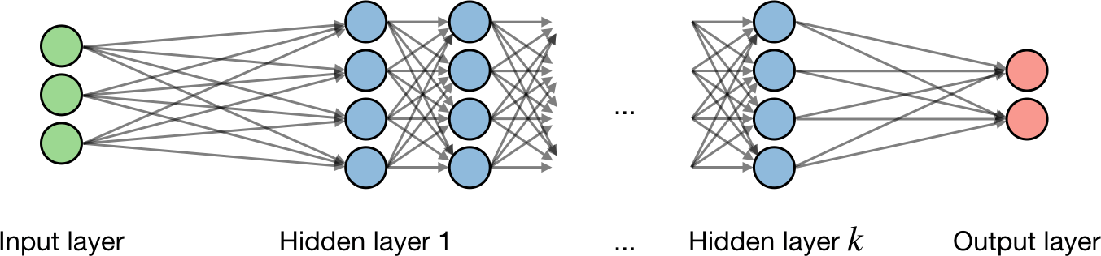
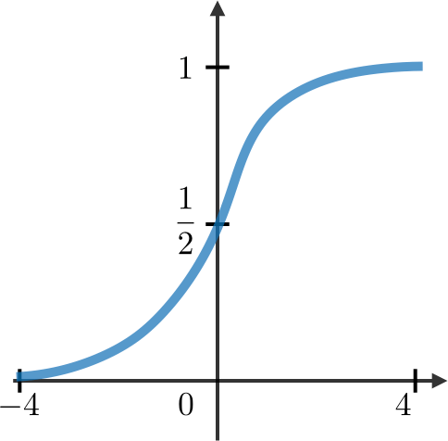
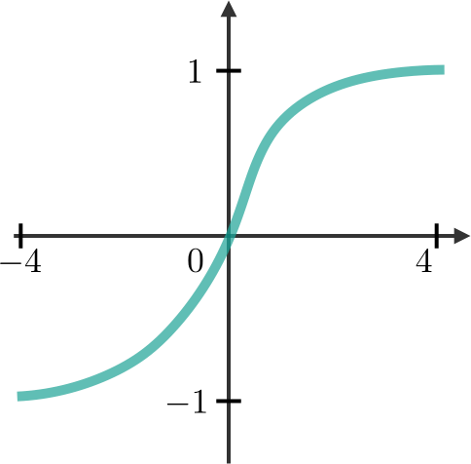
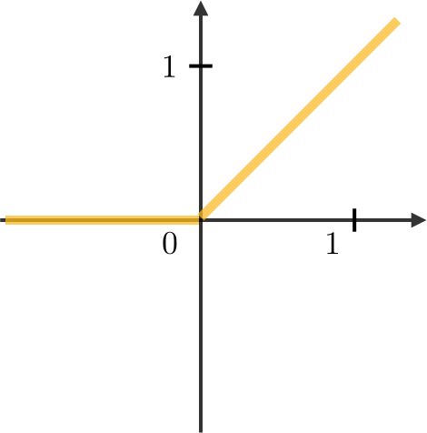
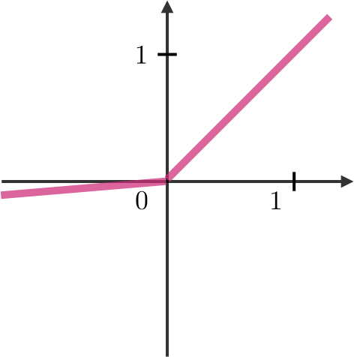
CS 229 – Machine Learning
Shervine Amidi & Afshine Amidi
Deep Learning
Neural Networks
Neural networks are a class of models that are built with layers. Commonly used types of neural networks include convolutional and recurrent neural networks.
Architecture – The vocabulary around neural networks architectures is described in the figure below:
∂L(z,y) ∂L(z,y) ∂a ∂z
∂w
∂w
=
× ×
∂a ∂z
As a result, the weight is updated as follows:
∂L(z,y) w ←− w − η _{∂w}
Updating weights – In a neural network, weights are updated as follows:
Step 1: Take a batch of training data.
Step 2: Perform forward propagation to obtain the corresponding loss.
Step 3: Backpropagate the loss to get the gradients.
By noting i the i^{th} layer of the network and j the j^{th} hidden unit of the layer, we have:
Step 4: Use the gradients to update the weights of the network.
T
[i] [i] [i]
Dropout – Dropout is a technique meant at preventing overfitting the training data by dropping out units in a neural network. In practice, neurons are either dropped with probability p or kept with probability 1 − p.
3.2 Convolutional Neural Networks
Convolutional layer requirement – By noting W the input volume size, F the size of the convolutional layer neurons, P the amount of zero padding, then the number of neurons N that fit in a given volume is such that:
z = w x + b_{j}
j j
where we note w, b, z the weight, bias and output respectively.
Activation function – Activation functions are used at the end of a hidden unit to introduce
non-linear complexities to the model. Here are the most common ones:
Sigmoid | Tanh | ReLU | Leaky ReLU
1 g(z) = _{1 + e−z} | _{e}z _{− e}−z g(z) = _{e}z _{+ e}−z | g(z) = max(0,z) | g(z) = max(sz,z) with s 1
_{N =} W − F + 2P ₊ ₁
S
Batch normalization – It is a step of hyperparameter γ, β that normalizes the batch {xi}.
By noting µ_{B}, σ² the mean and variance of that we want to correct to the batch, it is done as
follows:
B
x − µ
x ←− γ √
i B
+ β
i
2
σ + s
B
It is usually done after a fully connected/convolutional layer and before a non-linearity layer and aims at allowing higher learning rates and reducing the strong dependence on initialization.
Cross-entropy loss – In the context of neural networks, the cross-entropy loss L(z,y) is
commonly used and is defined as follows:
3.3 Recurrent Neural Networks
Types of gates – Here are the different types of gates that we encounter in a typical recurrent neural network:
L(z,y) = −^{Σ}y log(z) + (1 − y) log(1 − z)^{Σ}
Learning rate – The learning rate, often noted η, indicates at which pace the weights get updated. This can be fixed or adaptively changed. The current most popular method is called Adam, which is a method that adapts the learning rate.
Backpropagation – Backpropagation is a method to update the weights in the neural network by taking into account the actual output and the desired output. The derivative with respect to weight w is computed using chain rule and is of the following form:
Input gate | Forget gate | Output gate | Gate
Write to cell or not? | Erase a cell or not? | Reveal a cell or not? | How much writing?
LSTM – A long short-term memory (LSTM) network is a type of RNN model that avoids the vanishing gradient problem by adding ’forget’ gates.

Slide 9
CS 229 – Machine Learning
Shervine Amidi & Afshine Amidi
3.4 Reinforcement Learning and Control
The goal of reinforcement learning is for an agent to learn how to evolve in an environment.
Maximum likelihood estimate – The maximum likelihood estimates for the state transition
probabilities are as follows:
Markov decision processes – A Markov decision process (MDP) is a 5-tuple (S,A,{Psa},γ,R)
Psa
_{(sj) =} #times took action a in state s and got to s^{j}
where:
S is the set of states
A is the set of actions
#times took action a in state s
Q-learning – Q-learning is a model-free estimation of Q, which is done as follows:
Σ Σ
j j₎
Q(s,a) ← Q(s,a) + α R(s,a,s^{j}) + γ max Q(s ,a −
Q(s,a)
{P } are the state transition probabilities for s ∈ S and a ∈ A
_{a}r
sa
γ ∈ [0,1[ is the discount factor
R : S × A −→ R or R : S −→ R is the reward function that the algorithm wants to maximize
Policy – A policy π is a function π : S −→ A that maps states to actions.
Remark: we say that we execute a given policy π if given a state s we take the action a = π(s).
Value function – For a given policy π and a given state s, we define the value function V ^{π}
as follows:
V ^{π} (s) = E^{Σ}R(s0) + γR(s1) + γ²R(s2) + ...|s0 = s,π^{Σ}
Bellman equation – The optimal Bellman equations characterizes the value function V ^{π∗}
of the optimal policy π∗:
∗
Σ
j₎ π j₎
π
∗
V (s) = R(s) + max γ P
sa
(s V (s
a∈A
r
s ∈S
Remark: we note that the optimal policy π∗ for a given state s is such that:
∗₍
Σ
j₎ ∗₍ j₎
π s) = argmax P
sa
(s V s
a∈A
s^{r}∈S
Value iteration algorithm – The value iteration algorithm is in two steps:
We initialize the value:
V0(s) = 0
We iterate the value based on the values before:
Σ
Σ
Σ
j₎ j₎
V (s) = R(s) + max γP (s V (s
i+1 sa i
a∈A
r
s ∈S

Slide 10
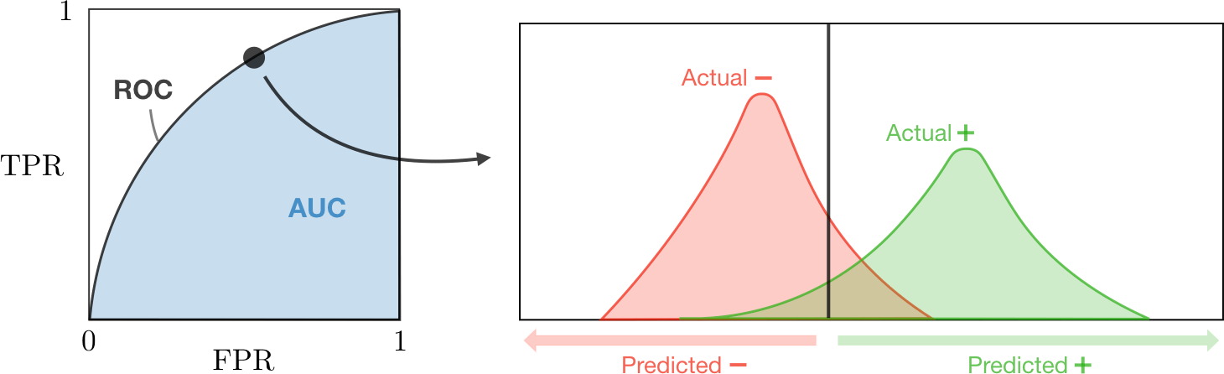
CS 229 – Machine Learning
Shervine Amidi & Afshine Amidi
Machine Learning Tips and Tricks
Metrics
Given a set of data points {x⁽¹⁾, ..., x^{(m)}}, where each x^{(i)} has n features, associated to a set of
Metric | Formula | Equivalent
True Positive Rate TPR | TP TP + FN | Recall, sensitivity
False Positive Rate FPR | FP TN + FP | 1-specificity
(1) (m)
outcomes {y , ..., y }, we want to assess a given classifier that learns how to predict y from
x.
4.1.1 Classification
In a context of a binary classification, here are the main metrics that are important to track to assess the performance of the model.
Confusion matrix – The confusion matrix is used to have a more complete picture when assessing the performance of a model. It is defined as follows:
Predicted class
+ –
AUC – The area under the receiving operating curve, also noted AUC or AUROC, is the area below the ROC as shown in the following figure:
+ | TP True Positives | FN False Negatives Type II error
– | FP False Positives Type I error | TN True Negatives
Actual class
4.1.2 Regression
Basic metrics – Given a regression model f , the following metrics are commonly used to assess the performance of the model:
Main metrics – The following metrics are commonly used to assess the performance of classification models:
Total sum of squares | Explained sum of squares | Residual sum of squares
_{Σ}m SStot = (yi − y)² i=1 | _{Σ}m SSreg = (f (xi) − y)² i=1 | _{Σ}m SSres = (yi − f (xi))² i=1
Metric | Formula | Interpretation
Accuracy | TP + TN TP + TN + FP + FN | Overall performance of model
Precision | TP TP + FP | How accurate the positive predictions are
Recall Sensitivity | TP TP + FN | Coverage of actual positive sample
Specificity | TN TN + FP | Coverage of actual negative sample
F1 score | 2TP 2TP + FP + FN | Hybrid metric useful for unbalanced classes
Coefficient of determination – The coefficient of determination, often noted R² or r², provides a measure of how well the observed outcomes are replicated by the model and is defined as follows:
2
SSres
R = 1 −
SStot
Main metrics – The following metrics are commonly used to assess the performance of regression models, by taking into account the number of variables n that they take into consid- eration:
Mallow’s Cp | AIC | BIC | Adjusted R²
SSres + 2(n + 1)σ² _{m}  | 2^{Σ}(n + 2) − log(L)^{Σ} | log(m)(n + 2) − 2 log(L) | 2 ₁ ₋ (1 − R )(m − 1) m − n − 1
ROC – The receiver operating curve, also noted ROC, is the plot of TPR versus FPR by varying the threshold. These metrics are are summed up in the table below:
is an estimate of the variance associated with each response.

where L is the likelihood and σ
2

Slide 11
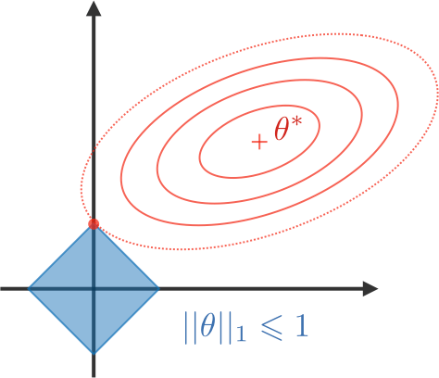
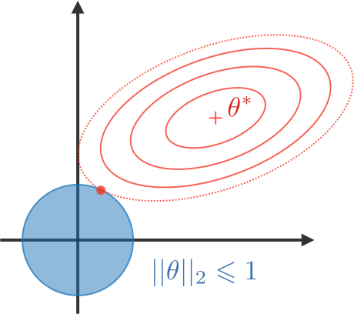
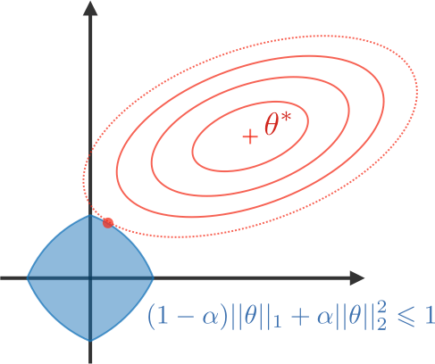
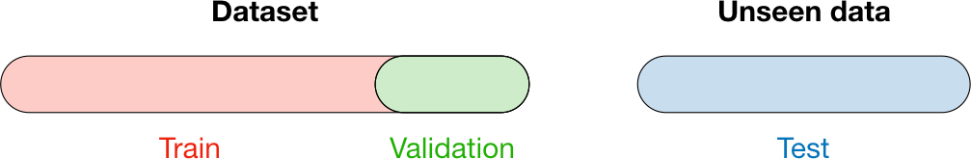
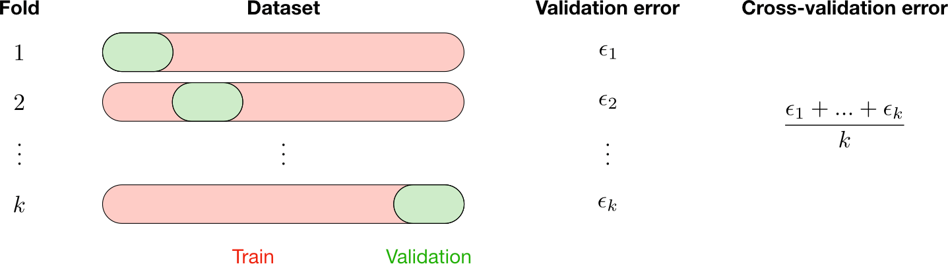
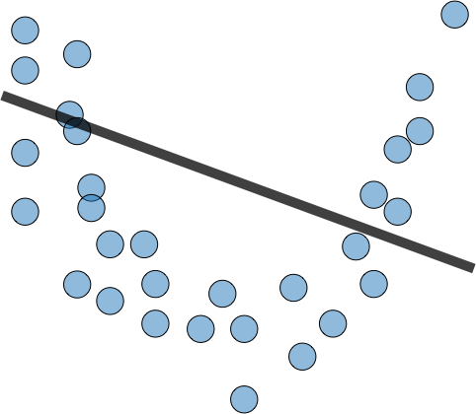
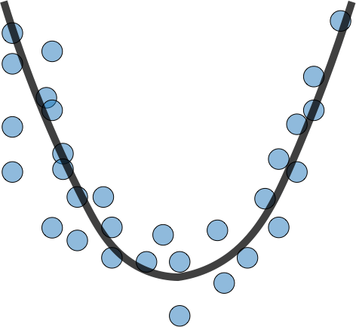
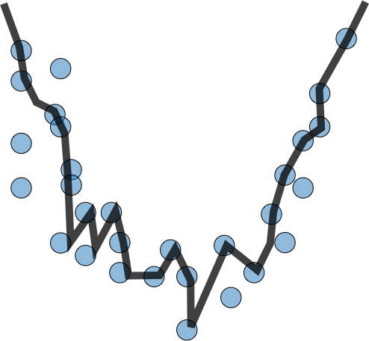
CS 229 – Machine Learning
Shervine Amidi & Afshine Amidi
4.2 Model selection
Vocabulary – When selecting a model, we distinguish 3 different parts of the data that we have as follows:
LASSO | Ridge | Elastic Net
Shrinks coefficients to 0 Good for variable selection | Makes coefficients smaller | Tradeoff between variable selection and small coefficients
... + λ||θ||1 λ ∈ R | ... + λ||θ||² 2 λ ∈ R | ... + λ^{Σ}(1 − α)||θ||1 + α||θ||^{2Σ} 2 λ ∈ R, α ∈ [0,1]
Training set | Validation set | Testing set
Model is trained Usually 80% of the dataset | Model is assessed Usually 20% of the dataset Also called hold-out or development set | Model gives predictions Unseen data
Once the model has been chosen, it is trained on the entire dataset and tested on the unseen test set. These are represented in the figure below:
Model selection – Train model on training set, then evaluate on the development set, then
Cross-validation – Cross-validation, also noted CV, is a method that is used to select a model that does not rely too much on the initial training set. The different types are summed up in the table below:
pick best performance model on the development set, and retrain all of that model on the whole
training set.
k-fold | Leave-p-out
Training on k − 1 folds and assessment on the remaining one Generally k = 5 or 10 | Training on n − p observations and assessment on the p remaining ones Case p = 1 is called leave-one-out
4.3 Diagnostics
Bias – The bias of a model is the difference between the expected prediction and the correct model that we try to predict for given data points.
Variance – The variance of a model is the variability of the model prediction for given data
points.
Bias/variance tradeoff – The simpler the model, the higher the bias, and the more complex the model, the higher the variance.
The most commonly used method is called k-fold cross-validation and splits the training data
into k folds to validate the model on one fold while training the model on the k − 1 other folds,
all of this k times. The error is then averaged over the k folds and is named cross-validation
error.
 | Underfitting | Just right | Overfitting
Symptoms | High training error Training error close to test error High bias | - Training error slightly lower than test error | Low training error Training error much lower than test error High variance
Regression
Regularization – The regularization procedure aims at avoiding the model to overfit the data and thus deals with high variance issues. The following table sums up the different types of commonly used regularization techniques:

Slide 12
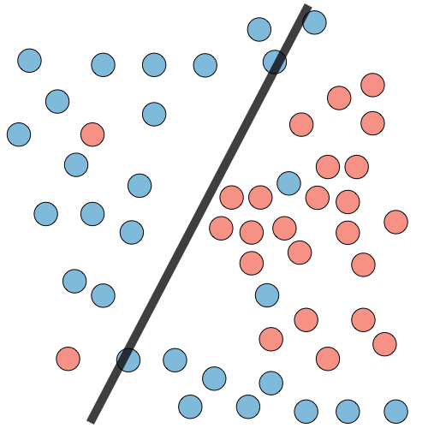
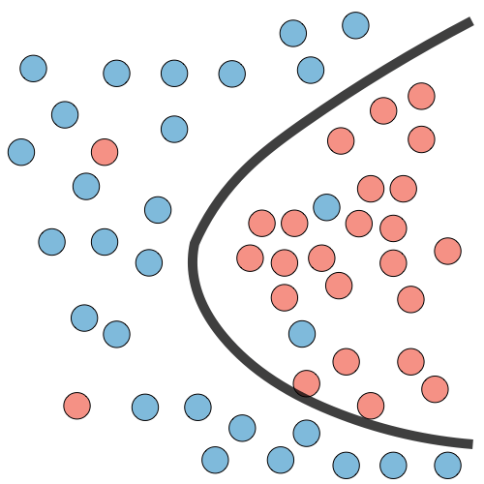
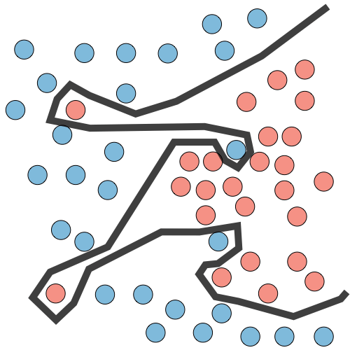
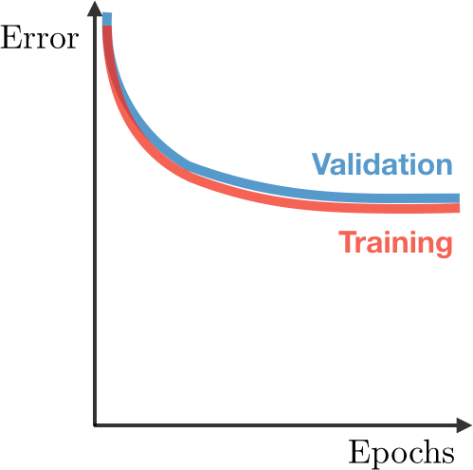
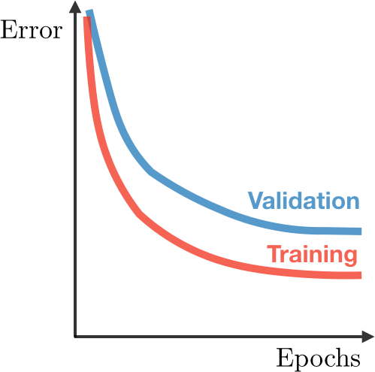
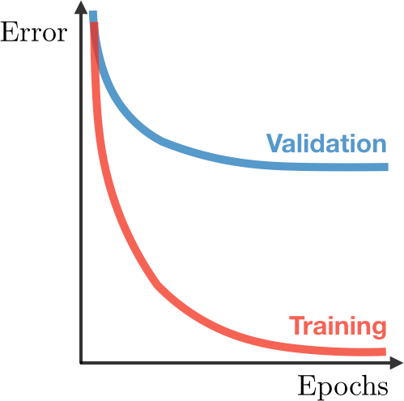
CS 229 – Machine Learning
Shervine Amidi & Afshine Amidi
Classification
Deep learning
Remedies | Complexify model Add more features Train longer |  | Regularize Get more data
Refreshers
Probabilities and Statistics
Introduction to Probability and Combinatorics
Sample space – The set of all possible outcomes of an experiment is known as the sample space of the experiment and is denoted by S.
Event – Any subset E of the sample space is known as an event. That is, an event is a set consisting of possible outcomes of the experiment. If the outcome of the experiment is contained in E, then we say that E has occurred.
Axioms of probability – For each event E, we denote P (E) as the probability of event E
occuring. By noting E1,...,En mutually exclusive events, we have the 3 following axioms:
. Σ
[ Σ
(1) 0 ™ P (E) ™ 1 (2) P (S) = 1
n n
(3) P Ei = P (Ei)
i=1 i=1
Permutation – A permutation is an arrangement of r objects from a pool of n objects, in a given order. The number of such arrangements is given by P (n, r), defined as:
n!
Error analysis – Error analysis is analyzing the root cause of the difference in performance between the current and the perfect models.
Ablative analysis – Ablative analysis is analyzing the root cause of the difference in perfor- mance between the current and the baseline models.
P (n, r) = _{(n − r)!}
Combination – A combination is an arrangement of r objects from a pool of n objects, where the order does not matter. The number of such arrangements is given by C(n, r), defined as:
C(n, r) =
P (n, r) n!
=
r! r!(n − r)!
Remark: we note that for 0 ™ r ™ n, we have P (n,r) “ C(n,r).
5.1.2 Conditional Probability
Bayes’ rule – For events A and B such that P (B) > 0, we have:
P (A|B) =
P (B|A)P (A)
P (B)
Remark: we have P (A ∩ B) = P (A)P (B|A) = P (A|B)P (B).
Partition – Let {Ai, i ∈ [ 1,n] } be such that for all i, Ai ƒ= ∅. We say that {Ai} is a partition if we have:
[
∀i ƒ= j, Ai ∩ Aj = ∅ and
n
Ai = S
i=1
Σ
n
Remark: for any event B in the sample space, we have P (B) = P (B|Ai)P (Ai).
i=1

Slide 13
CS 229 – Machine Learning
Shervine Amidi & Afshine Amidi
Extended form of Bayes’ rule – Let {Ai, i ∈ [ 1,n] } be a partition of the sample space.
Expectation and Moments of the Distribution – Here are the expressions of the expected value E[X], generalized expected value E[g(X)], k^{th} moment E[X^{k} ] and characteristic function ψ(ω) for the discrete and continuous cases:
We have:
P (B|A )P (A )
P (A |B) =
k k
k
Σ
n
P (B|A )P (A )
Case | E[X] | E[g(X)] | E[X^{k} ] | ψ(ω)
(D) | _{Σ}n xif (xi) i=1 | _{Σ}n g(xi)f (xi) i=1 | _{Σ}n x^{k}f (xi) i i=1 | _{Σ}n f (xi)e^{iωxi} i=1
(C) | ^{ˆ} +∞ ₍ ₎ xf x dx −∞ | ^{ˆ +∞} ( ) ( ) g x f x dx −∞ | ^{ˆ} +∞ ₍ ₎ x^{k}f x dx −∞ | ^{ˆ} +∞ ₍ ₎ f x e^{iωx}dx −∞
i i
i=1
Independence – Two events A and B are independent if and only if we have:
P (A ∩ B) = P (A)P (B)
5.1.3 Random Variables
Random variable – A random variable, often noted X, is a function that maps every element in a sample space to a real line.
Cumulative distribution function (CDF) – The cumulative distribution function F , which is monotonically non-decreasing and is such that lim F (x) = 0 and lim F (x) = 1, is
Remark: we have e^{iωx} = cos(ωx) + i sin(ωx).
Revisiting the k^{th} moment – The k^{th} moment can also be computed with the characteristic
function as follows:
Σ Σ
k
E[X^{k} ] =
1 ∂ ψ
defined as:
x→−∞ x→+∞
_{i}k
∂ω^{k}
ω=0
F (x) = P (X ™ x)
Transformation of random variables – Let the variables X and Y be linked by some function. By noting f_{X} and f_{Y} the distribution function of X and Y respectively, we have:
Remark: we have P (a < X ™ B) = F (b) − F (a).
Probability density function (PDF) – The probability density function f is the probability that X takes on values between two adjacent realizations of the random variable.
Relationships involving the PDF and CDF – Here are the important properties to know in the discrete (D) and the continuous (C) cases.
. dx .
X . .
f (y) = f (x)
Y
dy
Leibniz integral rule – Let g be a function of x and potentially c, and a, b boundaries that
may depend on c. We have:
. Σ
∂
∂c
ˆ
b
∂b ∂a ^{ˆ b} ∂g
Case | CDF F | PDF f | Properties of PDF
(D) | F (x) = ^{Σ} P (X = xi) x_{i}™x | f (xj ) = P (X = xj ) | 0 ™ f (xj ) ™ 1 and ^{Σ} f (xj ) = 1 j
(C) | ˆ _{x} F (x) = f (y)dy −∞ | dF f (x) = dx | ^{ˆ} +∞ f (x) “ 0 and f (x)dx = 1 −∞
a
g(x)dx = · g(b) − · g(a) + (x)dx
∂c ∂c ∂c
a
Chebyshev’s inequality – Let X be a random variable with expected value µ and standard deviation σ. For k, σ > 0, we have the following inequality:
1
P (|X − µ| “ kσ) ™ _{k2}
5.1.4 Jointly Distributed Random Variables
Variance – The variance of a random variable, often noted Var(X) or σ², is a measure of the spread of its distribution function. It is determined as follows:
Conditional density – The conditional density of X with respect to Y , often noted f_{X|Y} ,
Var(X) = E[(X − E[X])²] = E[X²] − E[X]²
is defined as follows:
f_{X|Y} (x) =
f_{XY} (x,y)
Standard deviation – The standard deviation of a random variable, often noted σ, is a measure of the spread of its distribution function which is compatible with the units of the actual random variable. It is determined as follows:
σ = √Var(X)
f (y)
Y
Independence – Two random variables X and Y are said to be independent if we have:
f_{XY} (x,y) = f_{X} (x)f_{Y} (y)

Slide 14
CS 229 – Machine Learning
Shervine Amidi & Afshine Amidi
Marginal density and cumulative distribution – From the joint density probability function f_{XY} , we have:
5.1.5 Parameter estimation
Case | Marginal density | Cumulative function
(D) | f_{X} (xi) = ^{Σ} f_{XY} (xi,yj ) j | F_{XY} (x,y) = ^{Σ Σ} f_{XY} (xi,yj ) x_{i}™x y_{j} ™y
(C) | ^{ˆ} +∞ f_{X} (x) = f_{XY} (x,y)dy −∞ | ˆ _{x} ˆ _{y} F_{XY} (x,y) = f_{XY} (x^{j},y^{j})dx^{j}dy^{j} −∞ −∞
Random sample – A random sample is a collection of n random variables X1, ..., Xn that are independent and identically distributed with X.
Estimator – An estimator θ^{ˆ} is a function of the data that is used to infer the value of an
unknown parameter θ in a statistical model.
Bias – The bias of an estimator θ^{ˆ} is defined as being the difference between the expected value of the distribution of θ^{ˆ} and the true value, i.e.:
Bias(θ^{ˆ}) = E[θ^{ˆ}] − θ
Distribution of a sum of independent random variables – Let Y = X1 + ... + Xn with
Remark: an estimator is said to be unbiased when we have E[θ^{ˆ}] = θ.
Sample mean and variance – The sample mean and the sample variance of a random sample are used to estimate the true mean µ and the true variance σ² of a distribution, are noted X and s respectively, and are such that:
X1, ..., Xn independent. We have:
Y
n
2
ψ (ω) = ψ (ω)
Y
X_{k}
Σ Σ
1
n
n n
k=1
X =
2
2
1
2
X and s = σ
ˆ =
(X − X)
i=1
i
n − 1
i=1
i
Covariance – We define the covariance of two random variables X and Y , that we note σ²
or more commonly Cov(X,Y ), as follows:
XY
Central Limit Theorem – Let us have a random sample X1, ..., Xn following a given
2
Cov(X,Y ) ¾ σ² = E[(X − µ_{X} )(Y − µ_{Y} )] = E[XY ] − µ_{X}µ_{Y}
distribution with mean µ and variance σ , then we have:
XY
. Σ
σ
Correlation – By noting σ , σ the standard deviations of X and Y , we define the correlation
X ∼ N µ, √_{n}
X
between the random variables
Y
X and Y , noted ρ , as follows:
n→+∞
XY
σ
2
ρ_{XY} =
XY
σ_{X}σ_{Y}
Linear Algebra and Calculus
General notations
Remarks: For any X, Y , we have ρ_{XY} ∈ [−1,1]. If X and Y are independent, then ρ_{XY} = 0.
Main distributions – Here are the main distributions to have in mind:
n
th
Vector – We note x ∈ R a vector with n entries, where x
i
∈ R is the i entry:
. Σ
x1
Type | Distribution | PDF | ψ(ω) | E[X] | Var(X)
(D) | X ∼ B(n, p) Binomial | P (X = x) = ^{.nΣ} p^{x}q^{n−x} x x ∈ [ 0,n] | (pe^{iω} + q)^{n} | np | npq
 | X ∼ Po(µ) Poisson | _{µ}x P (X = x) = e^{−µ} x ∈ N ^{x!} | _{e}µ(e^{iω} −1) | µ | µ
(C) | X ∼ U (a, b) Uniform | 1 f (x) = x ∈ [a,b^{b − a} ] | _{e}iωb _{− e}iωa (b − a)iω | a + b 2 | (b − a)² 12
 | X ∼ N (µ, σ) Gaussian | ₍ ₎ ₌ ₁ ₋ 1 . x−µ ^{Σ2} 2 σ f x √_{2πσ} e x ∈ R | 1 2 2 _{e}iωµ− ₂ ω σ | µ | _{σ}2
 | X ∼ Exp(λ) Exponential | f (x) = λe^{−λx} x ∈ R+ | 1 ₁ ₋ iω λ | 1 λ | 1 _{λ}2
x2
n
x = ∈ R
.
.
xn
Matrix – We note A ∈ R^{m×n} a matrix with m rows and n columns, where A ∈ R is the
entry located in the i^{th} row and j^{th} column:
i,j
. Σ
A1
· · · A1
A = .
,1 ,n
_{∈ R}m×n
.
Am,1
.
· · ·
.
Am,n
Remark: the vector x defined above can be viewed as a n × 1 matrix and is more particularly
called a column-vector.
Identity matrix – The identity matrix I ∈ R is a square matrix with ones in its diagonal
and zero everywhere else:
n×n
 
1 0 · · · 0

0
.
.
. . . . . .
.

I =

. . .
.
0

0
. . .
· · ·
0
1
14

Slide 15
CS 229 – Machine Learning
Shervine Amidi & Afshine Amidi
Remark: for all matrices A ∈ R^{n×n}, we have A × I = I × A = A.
T
n×n
∀i,j, A = A
Diagonal matrix – A diagonal matrix D ∈ R is a square matrix with nonzero values in
i,j
j,i
its diagonal and zero everywhere else:
 
d1 0 · · · 0
0 . . .
. . . . . .
0 · · · 0
Remark: for matrices A,B, we have (AB)^{T} = B^{T} A^{T} .
. . .
.

D = 
.
.
0
dn
Inverse – The inverse of an invertible square matrix A is noted A⁻¹ and is the only matrix
.
such that:
Remark: we also note D as diag(d1,...,dn).
AA⁻¹ = A⁻¹A = I
5.2.2 Matrix operations
Vector-vector multiplication – There are two types of vector-vector products:
inner product: for x,y ∈ R^{n}, we have:
Remark: not all square matrices are invertible. Also, for matrices A,B, we have (AB)⁻¹ =
_{B}−1_{A}−1
Trace – The trace of a square matrix A, noted tr(A), is the sum of its diagonal entries:
Σ
tr(A) =
n
Ai,i
Σ
i=1
Remark: for matrices A,B, we have tr(A^{T} ) = tr(A) and tr(AB) = tr(BA)
Determinant – The determinant of a square matrix A ∈ R^{n×n}, noted |A| or det(A) is
n
x^{T} y = xiyi ∈ R
i=1
outer product: for x ∈ R^{m}, y ∈ R^{n}, we have:
expressed recursively in terms of A_{\i,\j} , which is the matrix A without its i^{th} row and j^{th}
.
Σ
column, as follows:
x1y1 · · · x1yn
xmy1 · · ·
Σ
xy^{T} =
_{∈ R}m×n
n
.
.
det(A) = |A| = (−1)^{i+j} Ai,j |A_{\i,\j} |
xmyn
j=1
Matrix-vector multiplication – The product of matrix A ∈ R^{m×n} and vector x ∈ R^{n} is a
Remark: A is invertible if and only if |A| ƒ= 0. Also, |AB| = |A||B| and |A^{T} | = |A|.
5.2.3 Matrix properties
Symmetric decomposition – A given matrix A can be expressed in terms of its symmetric and antisymmetric parts as follows:
vector of size R^{n}, such that:
 
T
a x
Σ
r,1
 ₌
n
Ax = 
.
.
n
_{a}T
ac,ixi ∈ R
r,m
x
i=1
A =
A + A^{T} A − A^{T}
where a^{T} are the vector rows and ac,j are the vector columns of A, and xi are the entries
+
of x.
r,i
2 2
Matrix-matrix multiplication – The product of matrices A ∈ R^{m×n} and B ∈ R^{n×p} is a
S^{s}ym˛m¸etr^{x}ic An^{s}tisy˛m¸me^{x}tric
matrix of size R^{n×p}, such that:
 
a
T T
Norm – A norm is a function N : V −→ [0, + ∞[ where V is a vector space, and such that
b · · · a b
c,p
Σ
r,1
c,1
r,1
n
for all x,y ∈ V , we have:
N (x + y) ™ N (x) + N (y)
N (ax) = |a|N (x) for a scalar
if N (x) = 0, then x = 0
AB =
 
=
a b
T
∈ R
n×p
.
.
c,i
r,i
_{a}T
.
· · ·
_{a}T
.
i=1
r,m
bc,1
r,m
bc,p
where a^{T} , b^{T} are the vector rows and ac,j, bc,j are the vector columns of A and B respec-
tively.
r,i r,i
Transpose – The transpose of a matrix A ∈ R^{m×n}, noted A^{T} , is such that its entries are
flipped:
For x ∈ V , the most commonly used norms are summed up in the table below:
Stanford University
15
Fall 2018

Slide 16
CS 229 – Machine Learning
Shervine Amidi & Afshine Amidi
Norm | Notation | Definition | Use case
Manhattan, L¹ | ||x||1 | _{Σ}n |xi| i=1 | LASSO regularization
Euclidean, L² | ||x||2 | ‚.Σ^{n} , _{x}2 i i=1 | Ridge regularization
p-norm, L^{p} | ||x||p | ._{Σn} Σ 1 p _{x}p i i=1 | Hölder inequality
Infinity, L∞ | ||x||∞ | max |xi| i | Uniform convergence
.
Σ
₌ ∂f (A)
∇ f (A)
A
i,j ^{∂A}i,j
Remark: the gradient of f is only defined when f is a function that returns a scalar.
Hessian – Let f : R^{n} → R be a function and x ∈ R^{n} be a vector. The hessian of f with
2
respect to x is a n × n symmetric matrix, noted ∇ f (x
), such that:
. Σ
x
∂²f (x)
2
∇ f (x) =
x
∂x ∂x
i,j i j
Remark: the hessian of f is only defined when f is a function that returns a scalar.
Gradient operations – For matrices A,B,C, the following gradient properties are worth having in mind:
∇_{A}tr(AB) = B^{T}
∇_{A}T f (A) = (∇_{A}f (A))^{T}
Linearly dependence – A set of vectors is said to be linearly dependent if one of the vectors
∇_{A}tr(ABA^{T} C) = CAB + C^{T} AB^{T}
∇_{A}|A| = |A|(A⁻¹)^{T}
in the set can be defined as a linear combination of the others.
Remark: if no vector can be written this way, then the vectors are said to be linearly independent.
Matrix rank – The rank of a given matrix A is noted rank(A) and is the dimension of the vector space generated by its columns. This is equivalent to the maximum number of linearly independent columns of A.
Positive semi-definite matrix – A matrix A ∈ R^{n×n} is positive semi-definite (PSD) and is noted A ≤ 0 if we have:
A = A^{T} and
∀x ∈ R^{n}, x^{T} Ax “ 0
Remark: similarly, a matrix A is said to be positive definite, and is noted A ) 0, if it is a PSD matrix which satisfies for all non-zero vector x, x^{T} Ax > 0.
Eigenvalue, eigenvector – Given a matrix A ∈ R^{n×n}, λ is said to be an eigenvalue of A if there exists a vector z ∈ R^{n}\{0}, called eigenvector, such that we have:
Az = λz
Spectral theorem – Let A ∈ R^{n×n}. If A is symmetric, then A is diagonalizable by a real orthogonal matrix U ∈ R^{n×n}. By noting Λ = diag(λ1,...,λn), we have:
∃Λ diagonal, A = U ΛU^{T}
Singular-value decomposition – For a given matrix A of dimensions m × n, the singular- value decomposition (SVD) is a factorization technique that guarantees the existence of U m× m unitary, Σ m × n diagonal and V n × n unitary matrices, such that:
A = U ΣV ^{T}
5.2.4 Matrix calculus
Gradient – Let f : R^{m×n} → R be a function and A ∈ R^{m×n} be a matrix. The gradient of f
with respect to A is a m × n matrix, noted ∇_{A}f (A), such that:
Stanford University
16

